Slide 1
Do Now
Identify the tense for each of these sentence fragments from a scientific method. If they are not in the past tense, re-write them so that they are.
The ball is dropped from different heights.
The plant’s growth was observed every day.
The treatment will not be received by the control group.
A clear trend is shown by the data.
Fertiliser is added to each plant.

Slide 2
Do Now
Identify the tense for each of these sentence fragments from a scientific method. If they are not in the past tense, re-write them so that they are.
The ball was dropped from different heights.
The plant’s growth was observed every day.
The treatment was not be received by the control group.
A clear trend was shown by the data.
Fertiliser was added to each plant.

Slide 3
Tips to writing a good method:
Keep it clear and concise
Everything should be written in past tense
Make it step-by-step, in order of how you did it!
A method is a set of instructions that someone has followed, which is why it needs to be in the past tense.

Slide 4
Tips to writing a good method:
Keep it clear and concise
Everything should be written in past tense
Make it step-by-step, in order of how you did it!
A method is a set of instructions that someone has followed, which is why it needs to be in the past tense.

Slide 5
Observation
Using our senses
Inference
What we think is happening
Method
What somebody did in an experiment

Slide 6
Variables and Hypotheses
Success Criteria
I can define the terms variable and hypothesis
I can label variables as independent, dependent, or controlled
I can write a hypothesis

Slide 7
I can define the terms variable and hypothesis
Make an observation
Create a theory to explain the observation
Make a prediction on what will happen
Perform an experiment to test the prediction
Experiment result matches the prediction
Experiment result does not match the prediction
The theory might be correct.
The theory is wrong and must be changed.

Slide 8
I can define the terms variable and hypothesis
Before, we wanted to explore whether or not objects fell to the ground. We tried two different balloons, a box, and a book.
Each of these things and what they do are what we call variables, and underpin all of the scientific method. Using these variables, we can construct a hypothesis, or a prediction of what we expect to happen.

Slide 9
I can define the terms variable and hypothesis
Term | Definition
Variable | Anything that can be changed during an experiment
Independent variable | Only one variable that is changed on purpose
Dependent variable | What is measured and changes because of the independent variable
Controlled variable | All variables that are kept the same
Hypothesis | What we expect to happen to the dependent variable when the independent variable is changed

Slide 10
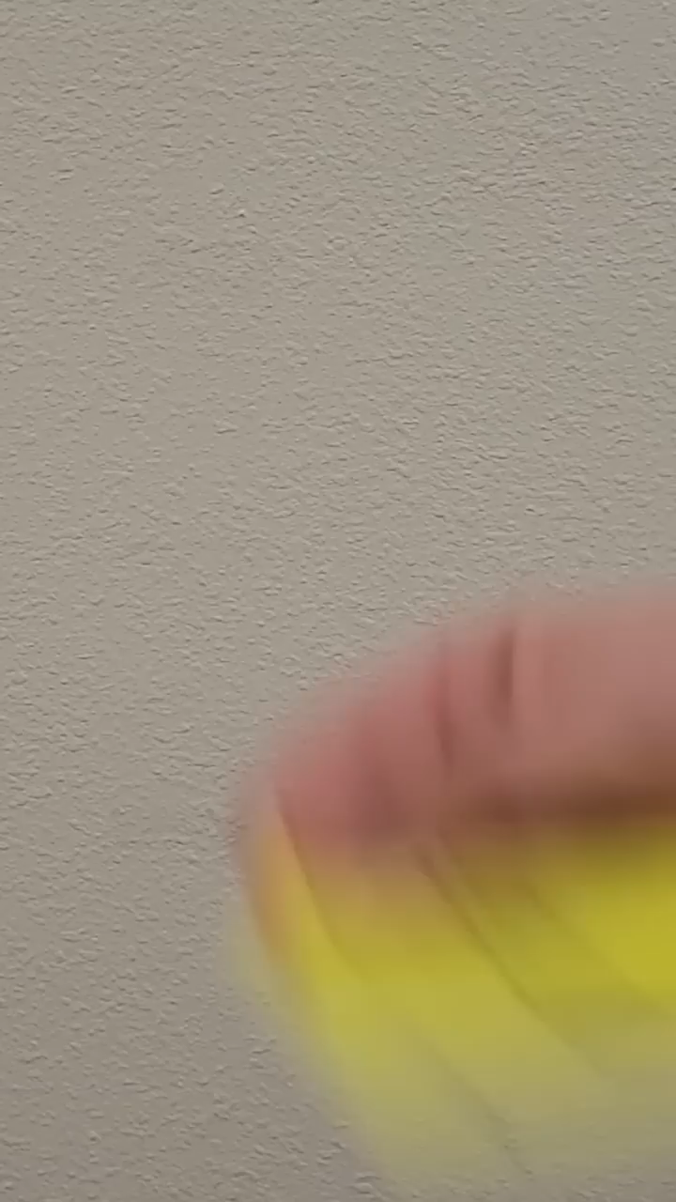
Brain Break
In this video, two of the facts shown are true, and the other is false. See if you can identify which is which before the end!
Notes:
https://www.youtube.com/shorts/0ZCifMan9z4 if video doesn’t work

Slide 11
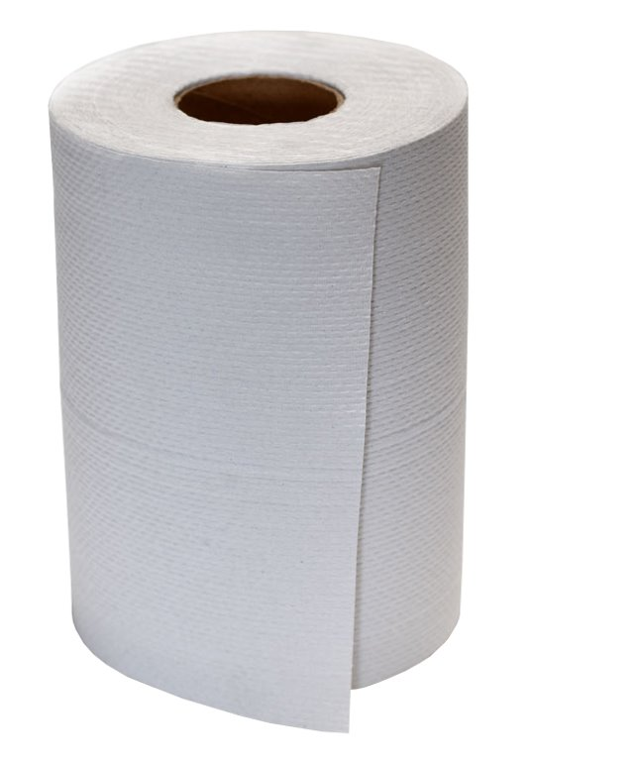
I can label variables as independent, dependent, or controlled
Will a brand name paper towel absorb more water than a generic paper towel?​
We have these materials: ​
250ml of water ​
measuring cylinder ​
tin pan ​
How would we answer this question?
Think-Pair-Share

Slide 12
I can label variables as independent, dependent, or controlled
In the method that we came up with, what are our:
Independent variables?
Dependent variables?
Controlled variables?
Can we ever have more than 1 independent or dependent variable?

Slide 13
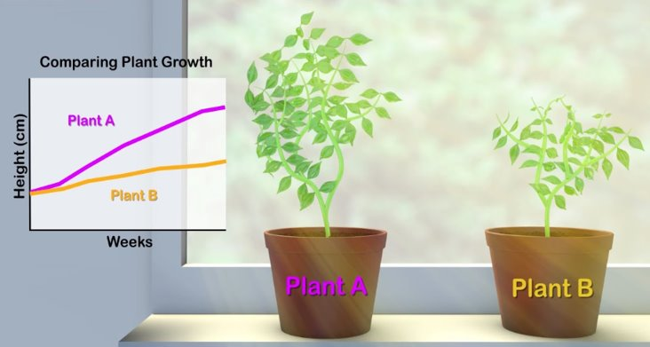
I can label variables as independent, dependent, or controlled
In this experiment, fertiliser was added to Plant A but not Plant B. The height of the plant was measured to see what change the fertiliser made.​
​
What is the independent variable?​
What is the dependent variable?​
What would be two controlled variables?​

Slide 14
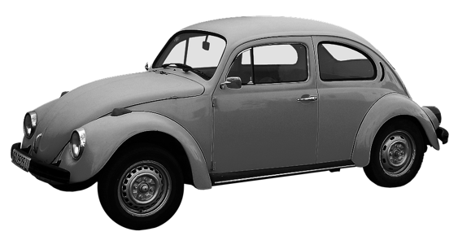
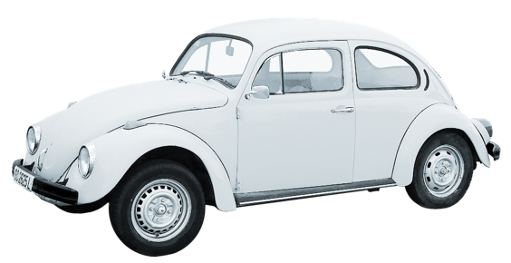
I can label variables as independent, dependent, or controlled
In this experiment, a grey car and a white car were parked in the sun. The temperature of each car was measured throughout the day to see which colour would heat up faster.​
​
What is the independent variable?​
What is the dependent variable?​
What would be two controlled variables?​

Slide 15

Brain Break
In this video, two of the facts shown are true, and the other is false. See if you can identify which is which before the end!
Notes:
https://www.youtube.com/shorts/8M_RKeDxeLs if video doesn’t work

Slide 16
I can write a hypothesis
A hypothesis is a prediction of what we expect to happen during a science experiment.
A hypothesis should relate the independent variable to the dependent variable, and have a direction!
E.g., when more water is added to plants, they will grow taller.

Slide 17
I can write a hypothesis
A hypothesis should usually be written in the following format:
When the independent variable increases/decreases, the dependent variable will increase/decrease.
For the plant example we just used:
When more water is added to plants, they will grow taller.

Slide 18
I can write a hypothesis
Let’s write hypotheses for each experiment we looked at today:
Type of variable | Variable
Independent | Amount of fertiliser
Dependent | Height of plant
Type of variable | Variable
Independent | Type of paper towel
Dependent | Amount of water absorbed
Type of variable | Variable
Independent | Colour of car
Dependent | Temperature of car

Slide 19
Variables and hypothesis
A variable is anything that can be changed during an experiment. An independent variable is changed on purpose, a dependent variable is measured and changes because of the independent variable, and a controlled variable is purposefully kept the same.
A hypothesis is a statement of what you expect to happen when you change the independent variable.

Slide 20
Variables and hypothesis
Before you ever do an experiment, you should have an idea about what will happen. Otherwise, an experiment might be unsafe!
At the same time, a hypothesis doesn’t have to be correct all the time. If we always knew exactly what would happen when we did an experiment, there would be no point in doing science, because we would already know everything!

Slide 21
Variables and Hypotheses
Success Criteria
I can define the terms variable and hypothesis
I can label variables as independent, dependent, or controlled
I can write a hypothesis

